Slide 1
2nd GODEX-NWP
NWP and Data Assimilation
KMA
Changhwan Kim
(blueedu@korea.kr)

Slide 2
Super Computer
[ Nuri/Miri]
- Cray XC40
4th Generation in KMA
Operational Period : 2016 ~ Current
Numbers of CPU Cores : 139,392 Cores(69,696Cores x 2, Intel Haswell)
Theoretical Performance : 5,800 TFlops
Top 500 Ranking(2018.11.)

Slide 3
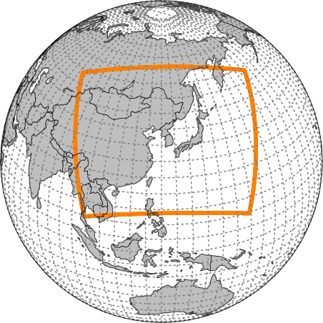
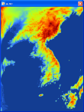
Operational Models
KMA’s operational models are based on Unified Model.
Global
Resolution
N1280L70(UM)
(~10km / top = 80km)
Target Length
288hrs (00/12UTC)
87hrs (06/18UTC)
Hybrid Ensemble 4DVAR
Local
Resolution
1.5~4km L70(UM)
(1188×1148 / top=39km)
Target Length : 36hrs
Initialization : 3DVAR
Local EPS
Resolution
3km L70(UM)
(460×482 / top = 39km)
Target Length : 72hrs
Members : 13
Global EPS
Resolution
N400L70(UM)
(~32km/ top = 80km)
Target Length : 288hrs
Members : 49
Regional
Resolution
12kmL70(UM)
(0.11°x0.11° / top=80km)
Target Length : 87hrs
Initialization : 4DVAR
Nowcasting
Resolution
1.5~4km L70(UM)
(1188×1148 / top=39km)
Target Length : 12hrs
Initialization : 3DVAR

Slide 4
Changes in operational system (2017.6.~2018.11.)
(2017 Oct 31) Global model upgraded
VarBC for radiance data(ATOVS, IASI, …)
updated all of NWP modules(OPS, VAR, UM, …)
(2017 Nov 27) Added new data for global model
AMSR-2, MWHS-2, SAPHIR
(2017 Dec 28) Changed NWP cut-off time
Observation cut-off time : +2h 25m → +2h 40m (+15mins delayed)
About 2~3% of observation data are increased.
(2018 Jan 27) Added new data for local model
MHS and Ground GNSS data was added.
(2018 Mar 6) Added MSG-4 AMV
(2018 Jun 5) Global model upgraded
resolution : 17km → 10km
VarBC for COMS CSR
updated all of NWP modules(OPS, VAR, UM, …)

Slide 5
Plans (2018.12.)
(2018 Dec)
Global model
NPP VIIRS, Metop AVHRR Polarwind, GOES-R AMV will be added.
Regional model
Global Model will replace regional model.
Local model
drift information of high resolution sonde.
Local EPS system
resolution change : 3km → 2.2km
some physics process will be updated.

Slide 6
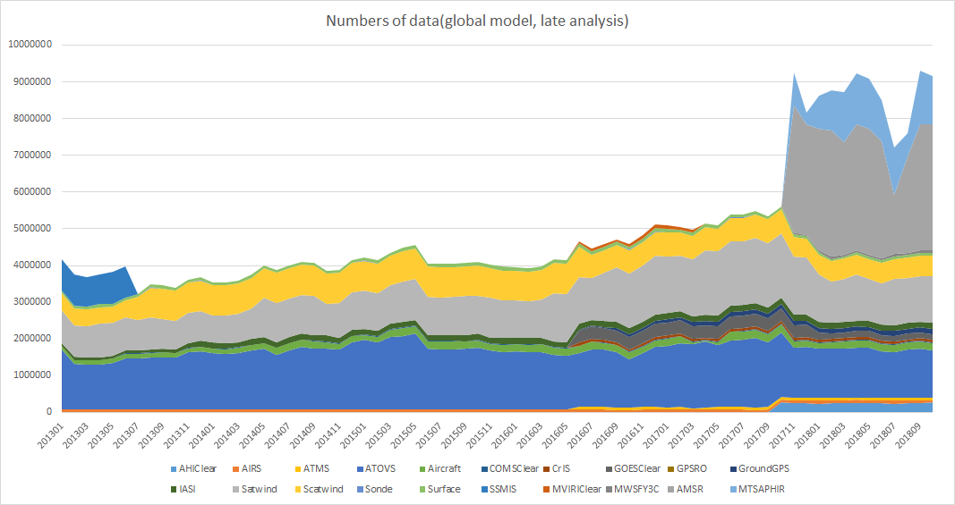
Data Usage (Global Model, 2013~2018)
SAPHIR
AMSR2
ASCAT
SSMIS
AMVs
ATOVS

Slide 7
Data Usage (Global Model, 2018.11.)
Data spices |  | Global | Regional | Local | Element
Surface | SYNOP | O | O | O | T, UV, RH, P, Vis | - Visibility data are assimilated for very short ranged LAM (2017)
 | BUOY | O | O | O | T, UV, RH, P, Vis
 | SHIP | O | O | O | T, UV, RH, P, Vis
 | METAR | O | O | O | T, UV, RH, P
 | AWS, AMEDAS |  | O | O | T, UV, RH | - Hourly data
Upper Air | Sonde | O | O | O | T, UV, RH | - preparing to use drift information
 | Dropsonde | O | O |  | T, UV, RH
 | PILOT Balloon | O | O | O | UV
 | Wind Profiler | O | O | O | UV | - Hourly data
Aircraft | AMDAR | O | O | O | T, UV
 | AIREP | O | O | O | T, UV
TC Bogus |  | O | O | O | MSLP

Slide 8
Data Usage (Global Model, 2018.11.)
Data spices |  | Global | Regional | Local | Element
ASCAT |  | O | O | O | UV | Coastal wind 12.5/25km(EUMETSAT)
AMV | Meteosat-8 | O |  |  |  | UV, IR (GTS)
 | Meteosat-11 | O |  |  |  | UV, IR (GTS)
 | GOES-E | Planned |  |  |  | UV, IR (NESDIS)
 | GOES-W | O |  |  |  | UV, IR (NESDIS)
 | Polarwind | O | O |  |  | UV, IR (NESDIS, CIMSS)
 | Himawari-8 | O | O |  |  | UV, IR (GTS)
 | COMS | O | O |  |  | UV, IR
 | LEOGEO | O |  |  |  | (CIMSS)
 | AVHRR, VIIRS | Planned |  |  |  | Metop-A/B, NPP (EUMETSAT)
ATOVS | AMSU, HIRS, MHS | O | O | MHS Only | Radiance | NOAA-15/18/19, Metop-A/B
IASI |  | O | O |  | Radiance | 314 channels, Global & direct read out
ATMS |  | O |  |  | Radiance | NPP
CrIS |  | O |  |  | Radiance | NPP

Slide 9
Data Usage (Global Model, 2018.11.)
Data spices |  | Global | Regional | Local | Element
AIRS |  | O | O |  | Radiance | AQUA
AMSR-2 |  | O |  |  | Radiance | GCOM-W1
MWHS-2 |  | O |  |  | Radiance | FY-3C
SAPHIR |  | O |  |  | Radiance | Megha-Tropiques
GNSS RO | COSMIC 1~6 | O | O |  | banding angle
 | Metop-A/B | O | O |  | banding angle
 | TanDem-X/TerraSAR-X | O |  |  | banding angle
CSR | COMS | O |  |  | Radiance
 | Meteosat-11 | Planned |  |  | Radiance
 | Meteosat-8 | O |  |  | Radiance | 2017.5~
 | GEOS-E | Planned |  |  | Radiance
 | GEOS-W | O |  |  | Radiance
 | Himawari-8 | O |  |  | Radiance
Ground based GNSS |  | O |  | O | ZTD
Rader |  |  |  | O | UV

Slide 10
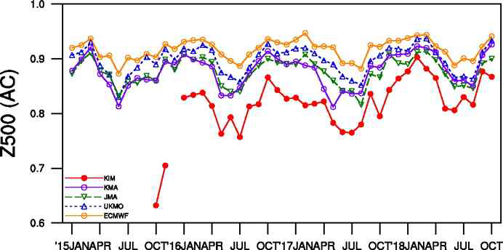
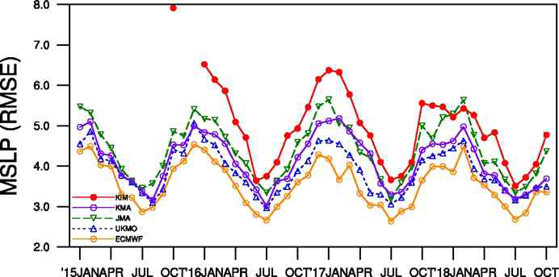
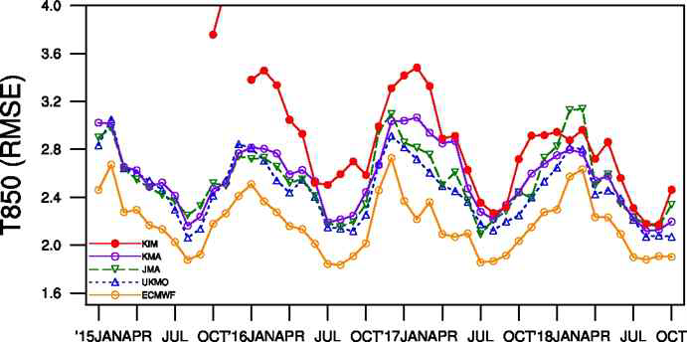
KIM(KIAPS Integrated Model) Model
Cubed sphere grid and Non-hydrostatic dynamical core
Aimed for global model and will be operated from 2020(planed).
Semi-operational phase in early 2019.
Performance is 94% of operational model in anomaly correlation(2018.10.).
KIM Global
Resolution
NE240L91(~12km)
Target Length : 240hrs
Initialization : KPOP, 4DEnVAR(50 members)
KPOP/HybDA
DA system for KIM
4DEnVAR(50 member)
include VARBC

Slide 11
Data distribution
GTS
Data spices | TAC | BUFR | Bulletin Header Name(BUFR) / RKSL
SYNOP | O | O(2016. 5.~) | ISCC01 (Climate) ISIC20, ISMC20 (South Korea) ISMI01, ISMK01 (Antarctic)
SHIP | O | O(2016. 5.~) | ISSX[01-02,11-12]
BUOY | O | O(2016. 5.~) | IOBC[19,41]
ARGO | O | O(2016. 5.~) | IOPX02
SONDE | O | O(2016. 5.~) | IUSC[01~06], IUKC[02~06] (South Korea) IUKN40, IUSN40 (Arctic sea) IUKK[01,02], IUKI[01,02] (Antarctic)
AMDAR |  | O | IUA[A-L,X]01
SAREP/SATOB |  | O | COMS AMV : IUCN[01~80] COMS CSR : IURX01 (2018.4.~)
DBNet
Satellite | Product | File Name
S-NPP (L1C) | CrIS (2018.8.~) | W_kr-KMA-jin,cris,DBNet+snpp+jin_C_RKSL_YYYYMMDDhhmmss_cris_snpp_YYYYMMDD_hhmm_bufr.bin
 | ATMS (2018.9.~) | W_kr-KMA-jin,atms,DBNet+snpp+jin_C_RKSL_YYYYMMDDhhmmss_atms_snpp_YYYYMMDD_hhmm_bufr.bin
Metop-A/B (L1C) | IASI(2017.2.~) | W_kr-KMA-jin,iasi,dbnet+metopa+jin_C_RKSL_{YYYYMMDDhhm{ss}_iasil1c_metop##_{YYYYMMDD}_{hhmm}_{orbit}_bufr.bin

Slide 12
Thank you for attention!

